Slide 1
Requirements Prioritization
Requirements prioritization is the process of managing the relative importance and urgency of different requirements to cope with the limited resources of projects.
Adequate prioritization ensures that the most critical requirements are addressed immediately in case time or budgets run out.
Notes:
Large software systems have a few hundred to thousands of requirements. Neither are all requirements equal nor do the implementation teams have resources to implement all the documented requirements. There are several constraints such as limited resources, budgetary constraints, time crunch, feasibility, etc., which brings in the need to prioritize requirements.
Most customers on their part have a reasonable idea of what they need and what they want. But during requirements elicitation the customer provides the Business Analyst (BA) with all the requirements that he feels will make his work easier. The customer is not wrong on his part; the BA needs to understand the needs of the business to prioritize the requirements.

Slide 2
Bubble Sort Technique
To prioritize requirements using bubble sort, you take two requirements and compare them with each other.
If you find out that one requirement should have greater priority over the other, you swap them accordingly.
You then continue in this fashion until the very last requirement is properly sorted.
The result is a list of requirements that are ranked.

Slide 3
Five Whys
It often happens that stakeholders want to implement a certain feature for reasons that are not founded on logical arguments or the business interests of the company.
With five whys, the analyst asks the stakeholder repeatedly (five times or less) why the requirement is necessary until the importance of the requirements is established.
The answers reveal whether the requirement is really necessary or can be cancelled/postponed once the priority is determined.

Slide 4
Requirements Prioritization
A common objection by stakeholders to requirements prioritization is that all requirements are important.
They often say, “Do I really have to prioritize the requirements? All of them are really important to us?”
We can respond to this argument with the simple answer, “No, of course not.
You don’t have to prioritize requirements, as long as you have unlimited time and resources.”

Slide 5
Requirements Prioritization
And that, of course, is what we don’t have on projects: unlimited time and unlimited resources (people, money, etc.). Prioritization is a way of dealing with the economics of projects: how do we allocate limited resources to maximize benefit?

Slide 6
Who Prioritizes?
Prioritization must be done in collaboration with the stakeholders (customer, product owner, project sponsor, and users) as early as possible so that alternatives can be explored.
Developers and stakeholders must work together as they often have conflicting views and needs.
Notes:
The BA can use any of the prioritization techniques to statistically prioritize the requirements. But, before prioritizing the requirements, the BA needs to understand the dependencies between the requirements. Creating a dependency map helps the cause.

Slide 7
Prioritization Guidelines
A common trap is to let the stakeholders choose the priorities without any guidance.
The analyst must guide the stakeholders through the prioritization process.

Slide 8
Prioritization Guidelines
The analyst should challenge the customer:
What are the consequences to the business objectives if this requirement were omitted?
Is there an existing system or manual process that could compensate?
Why can’t this requirement be deferred to the next release?
What business risk is being introduced if a particular requirement cannot be implemented right away?
Asking these questions allows the analyst to clarify whether a requirement is truly needed, if it can be deferred until a later release, or if it is really another project.

Slide 9
Techniques: Priority Scales
Effective prioritization requires the use of a ranking scale or some other ranking scheme.
A number of different scales are used in practice to indicate the relative importance of a requirement:
Categorical scales
Linear numeric scales.

Slide 10
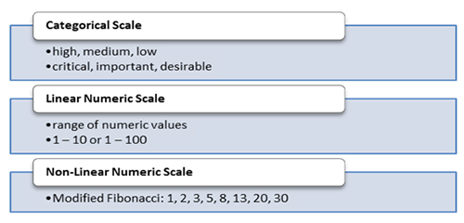
Priority Scales
Notes:
Once the requirements are prioritized, the list is ordered and implementation starts with the most important ones.

Slide 11
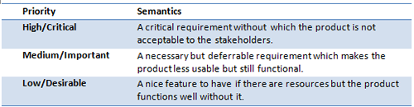
Priority Semantics
Notes:
Priority Semantics
All stakeholders need to understand what each priority value means. For a numeric scale, a small value means a low priority (reduced necessity and less urgency), while a large value indicates a high priority (necessary and urgent). For categorical scales, a definition of each categorical value needs to be established so that all stakeholders prioritize from the same perspective. The table summarizes the priority value semantics.

Slide 12
The requirements dependency map
Watch for requirement dependencies when prioritizing with the three-level scale.
You’ll run into problems if a high-priority requirement depends on another that’s planned for later implementation.

Slide 13
The requirements dependency map
let us take a scenario where you have 9 requirements X,Y,Z,P,Q,R,M,O and N with priorities, on a 5- level scale where 1 is most critical and 5 least critical, as 1,2,1,4,5,1,2,2,3.
So, with these priorities it would be logical to begin with requirements X, Z and R.
Notes:
Most requirements are interdependent and you will hardly find any requirement that exists independently. To understand why we need a dependency map – let us take a scenario where you have 9 requirements X,Y,Z,P,Q,R,M,O and N with priorities, on a 5- level scale where 1 is most critical and 5 least critical, as 1,2,1,4,5,1,2,2,3. So, with these priorities it would be logical to begin with requirements X, Z and R.
Now, consider the below dependency chart for the above requirements.

Slide 14
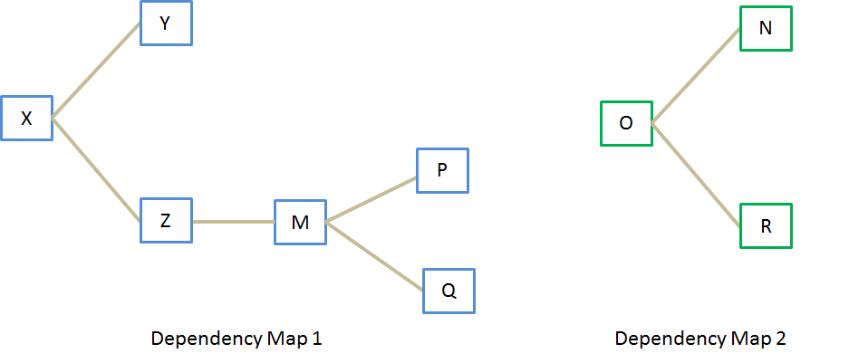
The requirements dependency map
Notes:
In the above requirements dependency map - requirements on the left are the root requirements. Requirements that are connected to the requirements on the left are dependent on them.
Now, consider the below dependency chart for the above requirements. The chart clearly brings out the idea that we need to complete X before commencing with Y, although X and Y have the same priority levels. Similarly, we need to complete O before commencing R, although when R has higher priority than O.

Slide 15
MoSCoW
The MoSCoW scheme changes the three-level scale of high, medium, and low into a four-level scale.
It doesn’t offer any rationale for making the decision about how to rate the priority of a given requirement compared to others.
MoSCoW is ambiguous as to timing, particularly when it comes to the “Won’t” rating: does it mean “not in the next release” or “not ever?”
The three-level scale that considers importance and urgency and focuses specifically on the forthcoming release or iteration. Agile projects often use the MoSCoW method

Slide 16
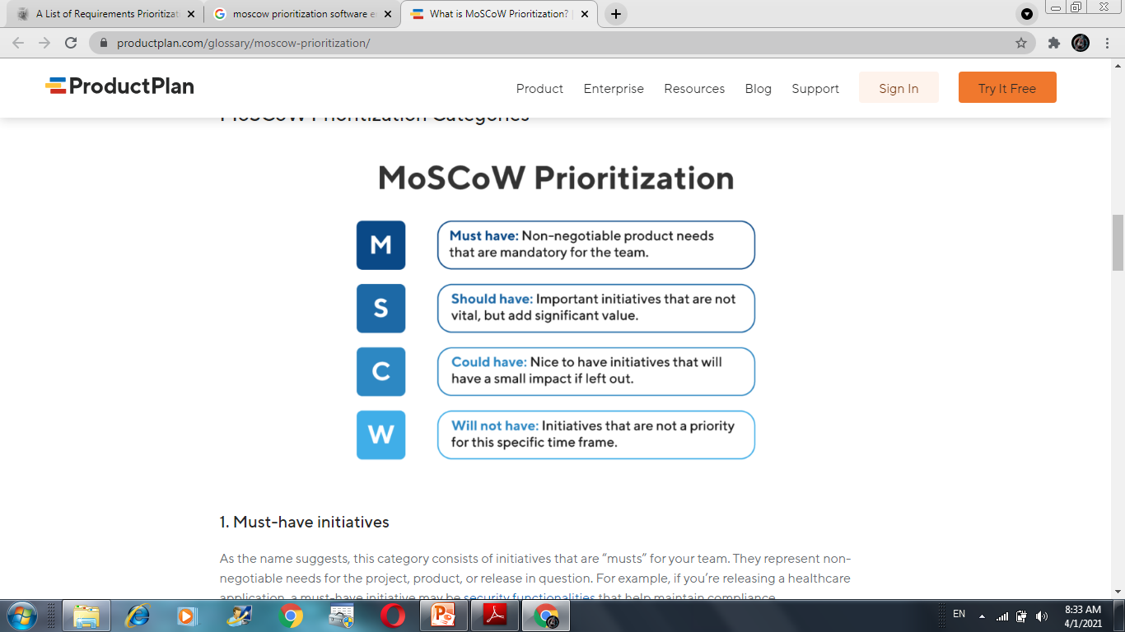
Notes:
For example, if you’re releasing a Finance or accounts related application, a must-have initiative may be security features that help maintain compliance.
If you’re unsure about whether something belongs in this category, ask yourself the following.
What happens if we release without this? Is there a workaround or a more simple way to accomplish this?
Will the release/project/product work without this initiative?
If the product won’t work without an initiative, or the release becomes useless without it, the initiative is most likely a “must-have.”

Slide 17
Notes:
Should-have initiatives are just a step below must-haves. They are important to the product, project, or release, but they are not vital. If left out, the product or project still functions. However, if they are included, they add significant value.
For example, performance improvements, minor bug fixes, or new functionality, may be “should-have” initiatives. Without them, the product still works.

Slide 18
Notes:
Another way of describing “could-have” initiatives is nice-to-haves. “Could-have” initiatives are not necessary to the core function of the product. Compared with “should-have” initiatives, they have a much smaller impact on the outcome if they are left out.

Slide 19
Notes:
One benefit of the MoSCoW method is that it places several initiatives in the “will-not-have” category. This helps manage expectations about what will not be included in a specific release (or another timeframe you’re prioritizing for). Some initiatives in the “will-not-have” group will get prioritized in the future, while others are not likely to happen at all.

Slide 20
When Do You Use the MoSCoW Method for Prioritization?
MoSCoW prioritization is an effective prioritization method for teams who would like to include representatives from the whole organization in their process.
Capture a broader perspective by including participants from various functional departments.
Notes:
Another reason you may want to use MoSCoW prioritization is it allows your team to determine how much effort goes into each category. Therefore, you can ensure that you’re delivering a good variety of initiatives in each release.
While in its initial iteration, the MoSCoW method was intended for time-boxed projects only, it can be modified and made effective beyond the scope of simple release planning.

Slide 21
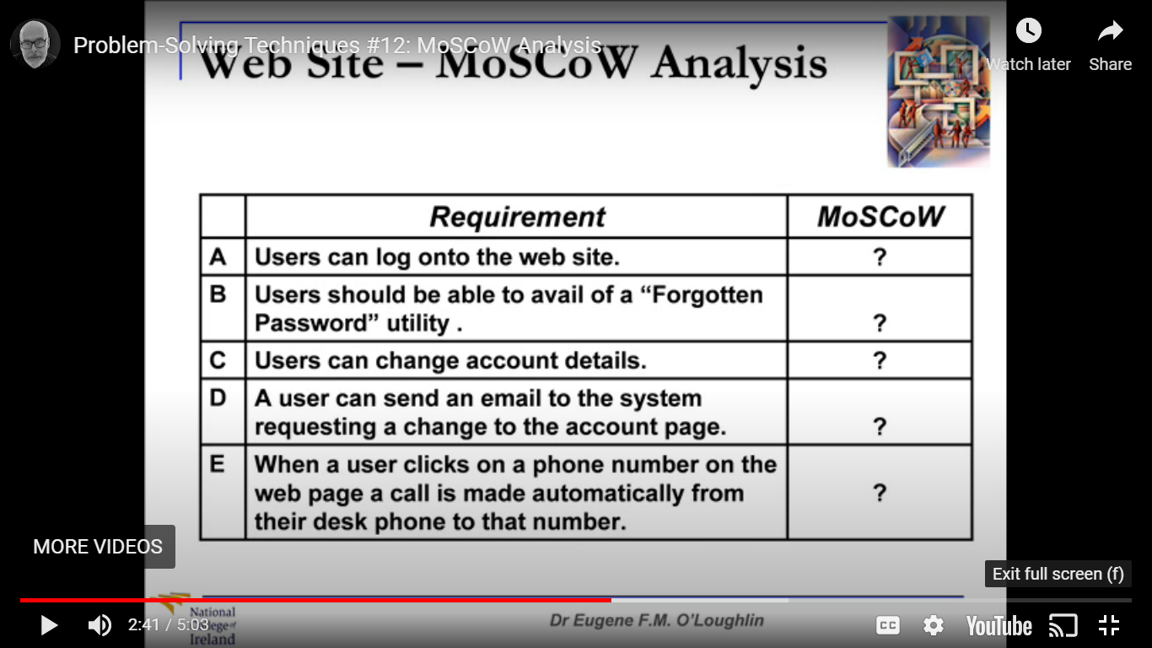
Example

Slide 22
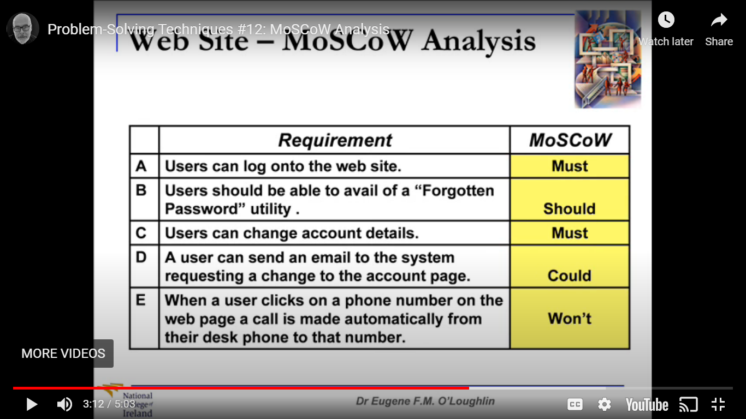
Examples

Slide 23
Hundred Dollar
All stakeholders get a conceptual 100 dollars, which they can distribute among the requirements.
The higher the amount allocated to each requirement, the higher the priority of the requirement.
At the end, the total is counted and the requirements are sorted based on the number of points received.
Notes:
Give the prioritization team 100 imaginary dollars to work with. Team members allocate these dollars to “buy” items they’d like to have implemented from the set of candidate requirements. Allocating more dollars weights the higher-priority requirements more heavily. If one requirement is three times as important to a stakeholder as another, she might assign nine dollars to the first requirement and three dollars to the second.

Slide 24
Hundred Dollar: Limitations
This technique should only be used when you have a small group of requirements to prioritize.
With this technique, however, it can be difficult to keep track of how much has been assigned and what amount is left to dispose of.

Slide 25
Requirements Traceability
Requirements traceability refers to the ability to describe and follow the life of a requirement, in both forwards and backwards direction (i.e. from its origins, through its development and specification, to its subsequent deployment and use, and through all periods of on-going refinement and iteration in any of these phases.
Notes:
Requirements traceability refers to the capability of a requirements management process or tool which enables the process participant or tool user to follow the life of a requirement both forwards and backwards. It also refers the the ability to link requirements (via specific relationships) to other constructs or artifacts of the product developmetnt lifecycle.

Slide 26
Requirements Traceability
Performing a requirements traceability analysis is an important part of the software engineering process as it ensures that all of the requirements have been adequately considered during each phase of the project, and that there aren't any scope 'holes' in the developed system due to missed requirements.

Slide 27
Requirements Traceability
Traceability may document relationships between many kinds of development artifacts, such as requirements, specification statements, designs, tests cases, models and developed components.
For example, it is common practice to capture verification relationships to demonstrate that a requirement is verified by a certain test artifact.
Notes:
Verification process includes checking of documents, design, code and program whereas Validation process includes testing and validation of the actual product. Verification does not involve code execution while Validation involves code execution-The validation process involves activities like unit testing, integration testing, system testing and user acceptance testing. Validation in Software Testing is a dynamic mechanism of testing and validating if the software product actually meets the exact needs of the customer or not. Verification in Software Testing is a process of checking documents, design, code, and program in order to check if the software has been built according to the requirements or not-The verification process involves activities like reviews, walk-throughs and inspection.

Slide 28
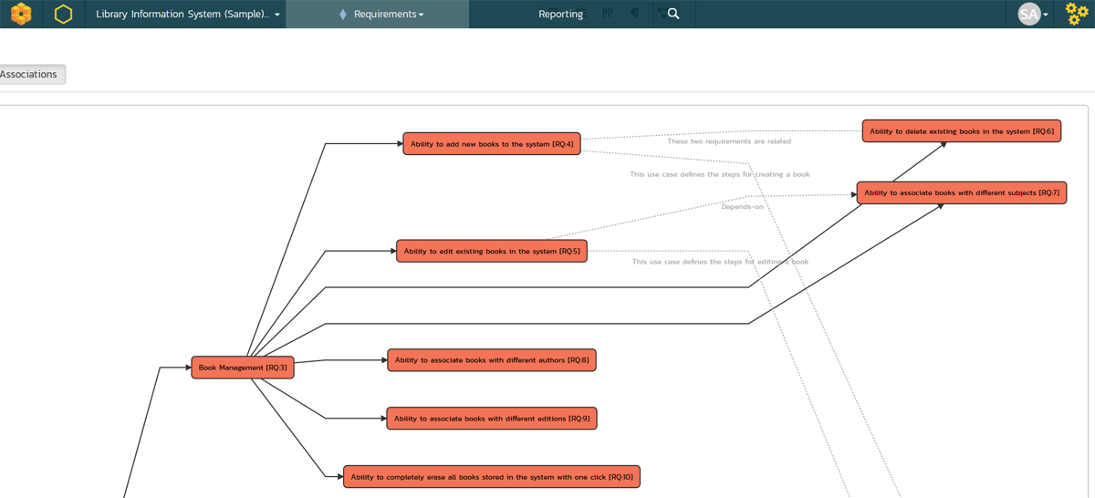

Slide 29
Types :Requirements Traceability
Customer needs are traced forward to requirements, so that you can tell which requirements will be affected if those needs change.
Conversely, you can trace backward from requirements to customer needs to identify the origin of each software requirement.
You can trace forward from requirements by defining links between individual requirements and specific product elements.
Specific product elements [may be traced] backward to requirements so that you know why each item was created.
Notes:
A requirement may be traced in one of four distinct ways, according to Karl Weigers in his book Software Requirements
“Customer needs are traced forward to requirements, so that you can tell which requirements will be affected if those needs change.
Conversely, you can trace backward from requirements to customer needs to identify the origin of each software requirement.
You can trace forward from requirements by defining links between individual requirements and specific product elements.
Specific product elements [may be traced] backward to requirements so that you know why each item was created.”

Slide 30
Usage of traceability information
Change impact analysis – if a requirement is changing, trace links inform about related and dependent artifacts.
These artifacts can easily be verified and if required be adjusted.
The probability to overlook related artifacts is reduced.
Coverage analysis – traceability ensures that no requirements are overlooked.
Especially when certifying safety-critical products it is necessary to demonstrate that all requirements are realized.

Slide 31
Usage of traceability information
Project status analysis – tracking of the project status is possible: analyzing the traceability data allows seeing the completion status of the requirements.
Requirements without links or with incomplete trace chain (e.g. requirements with implementation but without tests) indicate that further work is necessary.
The missing links show which concrete artifacts are missing and need to be realized.

Slide 32
Usage of traceability information
Persisting relationships – often knowledge of a project or product is in the head of specific persons.
By use of traceability this knowledge is saved by visualizing the relation between the different artifacts.
This knowledge remains even if a person leaves the project.
Test optimization – by linking requirements, source code, test cases and test results it is easy to identify affected parts of the source code if tests fail.
Furthermore, redundant test cases can be identified and eliminated.

Slide 33
Techniques/Methods Visualization of traceability information
One goal of traceability is to visualize the relationship between artifacts.
As the number and complexity of trace links increases, techniques for traceability visualization are necessary.
A visualization can include information about the artifacts (e.g. artifact type, metadata, attributes)
Notes:
RTM, Traceblity Graph, Lists, Hyperlinks

Slide 34
Requirement Traceability Matrix (RTM)
Requirement Traceability Matrix (RTM) is a document that maps and traces user requirement with different artifacts-test cases.
The main purpose of Requirement Traceability Matrix is to validate that all requirements are checked via test cases such that no functionality is unchecked during Software testing.

Slide 35
A TEST CASE
A TEST CASE is a set of conditions or variables under which a tester will determine whether a system under test satisfies requirements or works correctly.
The process of developing test cases can also help find problems in the requirements or design of an application.
Examples : Test cases for login panel
Test if user is able to login successfully.
Test if unregistered users is not able to login to the site
Test with valid username and empty password such that login must get failed
Test with empty username and valid password such that login must get failed
Notes:
Test with empty username and empty password and check if login fails
Check of the password is masked on the screen i.e., password must be in bullets or asterisks
Check if the login function handles case sensitivity
After logging in try to copy/cut the password and paste it on another screen(passwords are usually in * such that its not visible on the screen)
Verify account lock
Check if on selecting back button (after logging out) if the user is not signed in
Verify the url without logging into to the site
Automatic logout of the site when pressing backspace button

Slide 36
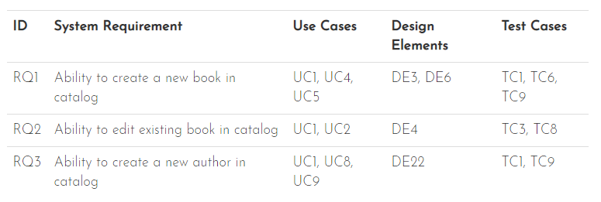
Types-Forward Traceability
Document the associations between the system requirements and the various artifacts created during the design, development and testing of the system.
Notes:
Forward Traceability
This refers to the need to document the associations between the functional and system requirements and the various artifacts created during the design, development and testing of the system.

Slide 37
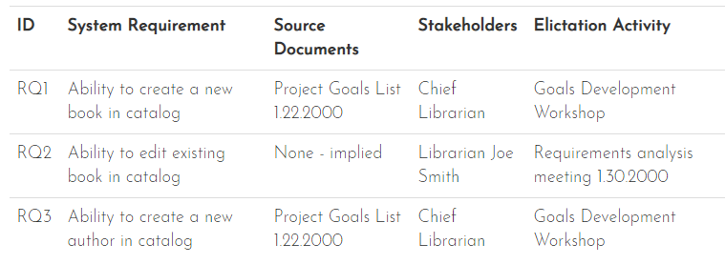
Types-Backwards / Reverse Traceability
To document the lineage and source of all the requirements defined in the System Requirements Specification (SRS).
Notes:
Backwards / Reverse Traceability
This refers to the need to document the lineage and source of all the requirements defined in the System Requirements Specification (SRS). As described in the section on techniques and activities for Requirements Gathering, requirements come from many different sources (written list from the customer representative, interviews with stakeholders, discussions with developers, workshop deliverables, focus groups of end-users, etc.).

